Slide 1


Slide 2
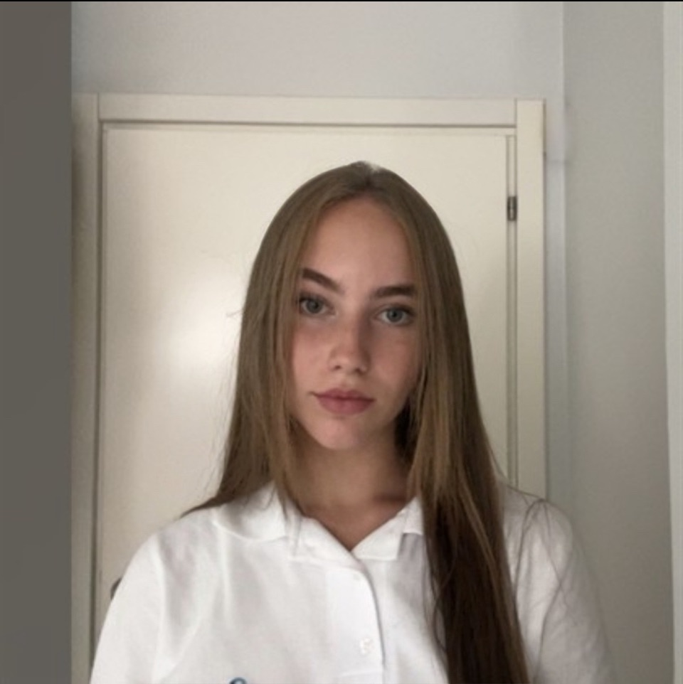
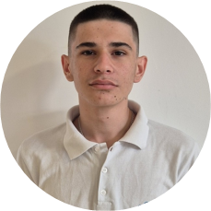

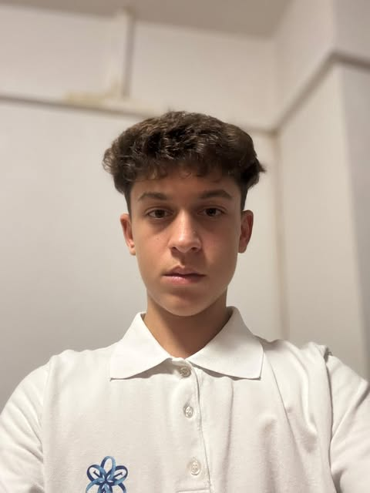
Our Team
Scrum Trainer
9B
Back-End Developer
9B
Iveta Noneva
Galin Enev
Maria Pavlova
Velin Markov
Front-End Developer
9 A
Front-End Developer
9 G

Slide 3
Our Idea
Nexora is an educational game for learning and testing knowledge.
Multiplayer mode makes learning competitive.
Players answer questions and improve their skills.
Players can see scores and achievements.
Each user can save their progress.
Nexora makes studying more enjoyable.

Slide 4
Stages of development
1
Creating logo and discussing ideas about the game
2
Making the design
and implementing our ideas through code
3
Developing the code
2 WEEK
3 WEEK
1 WEEK
4 WEEK
4
Creating the documentation and presentation

Slide 5






Used Technologies
1 week
2 week
3 week
4 week

Slide 6
Let’s move to the
DEMONSTRATION !

